Slide 1



Deuterated Formaldehyde as a Tracer of Core and Filament Evolution
Grace Kaiser
Dr. Yancy Shirley
University of Arizona

Slide 2
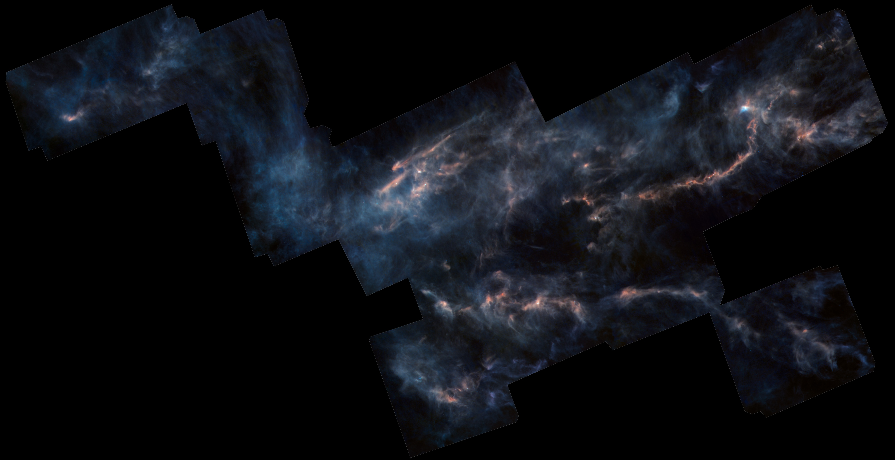
Molecular Clouds
Dust and gas, mostly H₂
Raw materials where stars and planets can form
Image Credit: ESA/Herschel/NASA/JPL-Caltech CC BY-SA 3.0 IGO; Acknowledgement: R. Hurt (JPL-Caltech)
Notes:
Let’s start big. What we observed was part of a molecular cloud. Molecular clouds are essentially cold, dense regions of gas and dust that are prime for the formation of stars and planets. We were looking at what you see here, the Taurus Molecular Cloud

Slide 3
Hierarchical Structure
Molecular Cloud
Filament
Starless Core
Notes:
We can characterize the structure in these clouds in the following way with filaments and cores

Slide 4
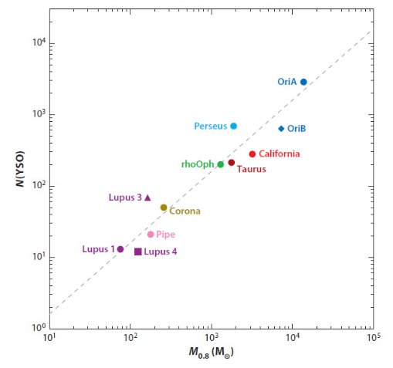
Cores and Filaments
Filaments: “threads” of dense gas
Starless cores: even denser parts of clouds, often on filament “threads,” building blocks of star formation
Number of Protostars
Mass of “dense gas”
Image Credit: Kennicutt & Evans 2012​, Lombardi & Alves 2010
Notes:
We know star and planetary formation is going to occur in these densest regions, we can see the filamentary structure, which you can think of like longer threads or strips of dense gas, and within those, even denser regions called starless cores. These cores very cold and, again, dense regions and are the building blocks of star formation. Thus they can set the initial conditions of future stars or planets should they collapse to form them, which is why we want to understand them and their evolution.

Slide 5
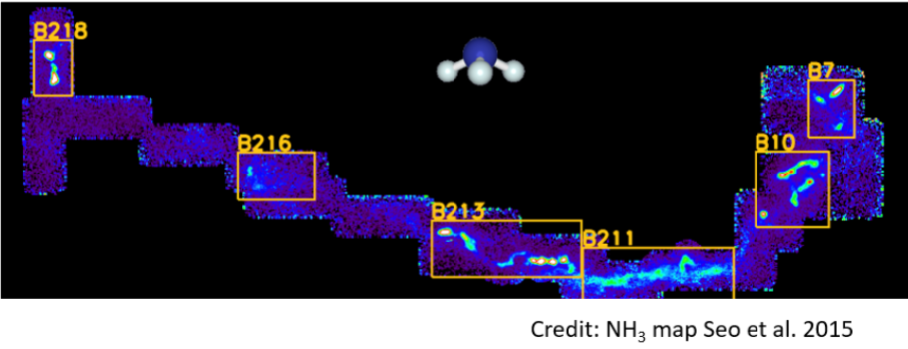
Finding Dense Regions
Ammonia used to trace the densest regions of the cloud
Notes:
Ammonia, which is excited by collisions, acts as a good tracer of these regions. The denser you are, the more collisions you have.
Defines where the dense cores are
w/I dense gas, other molecules like formaldehyde that can deuterate

Slide 6
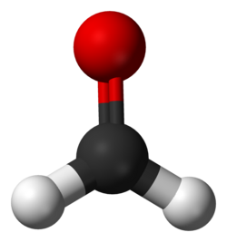
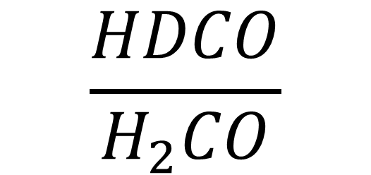
Deuterium Fractionation
$$\frac{HDCO}{H_{2}CO}$$
Ratio between deuterated and standard molecule
Occurs cold, dense gas
  i.e. starless cores
Tracer of evolution
Notes:
One way we can learn about these filaments and cores and their evolution is with deuterium fractionation. Deuterium fractionation describes the ratio between a deuterated molecule and its standard counterpart. Deuterated meaning a hydrogen atom has been replaced by its heavier isotope, deuterium. This deuteration tends to happen in cold, dense gas like the starless cores I mentioned previously. As the cores evolve, they build up deuterated molecules over time, which makes them good tracer of evolutionary history: a higher deuteration ratio corresponds to a more evolved core. Plus, it is very easy to find, which is why we are looking for it specifically to trace evolutionary trends

Slide 7
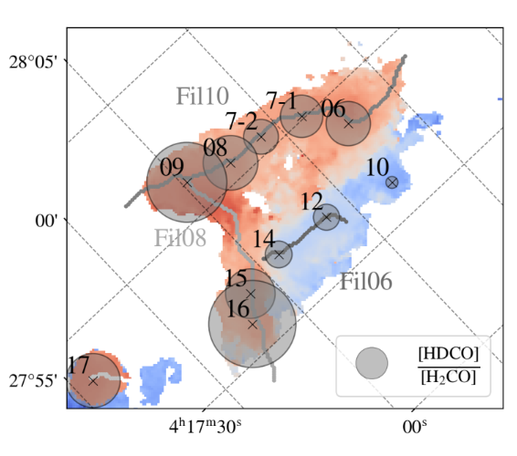
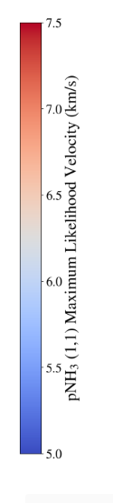
Previous Projects
B10 region of the Taurus Molecular Cloud
Spatial correlation in deuterium fractionation
Since it is a tracer of evolutionary history, maybe filaments evolve together!
Image Credit: Andras-Letanovszky et al. in prep
Notes:
In a previous Space Grant project focused on the B10 Region of the Taurus Molecular Cloud, there was a generally a spacial correlation found in deuteration, meaning cores in one filament had similar ratios compared to another filament. Since deuterium fractionation is a tracer of evolutionary history as more deuterium builds up as the starless core evolves, this leads to the conclusion that perhaps the whole filaments evolve at a similar rate. However, the project only covered the one region

Slide 8
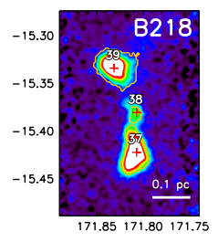
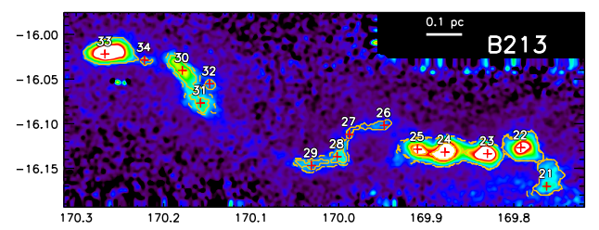
We’re Expanding!
Looking to see if the same trends hold in filaments with more starless cores
Goal: observe ratio between deuterated formaldehyde (HDCO) and formaldehyde (H₂CO) and compare that to various aspects of the filaments
B213 C
B213 E
Image Credits: Seo et al. (2015)
Notes:
So this project acts as a sort of continuation to see if the same trends are observed. We looked at 3 filaments, all of which have 3 or more cores in the B213 and B218 regions. The overall goal is to observe the ratio between the formaldehyde and deuterated formaldehyde and compare those ratios with aspects of the core like location and density to study potential trends in evolution and see if the trend observed previously holds elsewhere

Slide 9
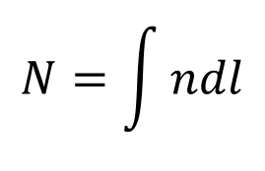



How do we achieve this?
Compare their column densities
To find the column densities, need to observe the molecules
Can’t see molecules, but can see when they change energy!
$$L$$
$$N=\int{ndl}$$
$$n=\# molecules/{cm}^{3}$$
$$N=\# molecules/{cm}^{2}$$
Notes:
The ratio that I am talking about compares the column densities of HDCO and H2CO. Essentially, the column density is the number of molecules in a given volume in space projected onto the area that we actually observe. To determine the column densities and figure out how many molecules there are of each, we need to observe the molecules. Obviously, it’s a little hard to do that, but it is much easier to observe when these molecules change energy

Slide 10
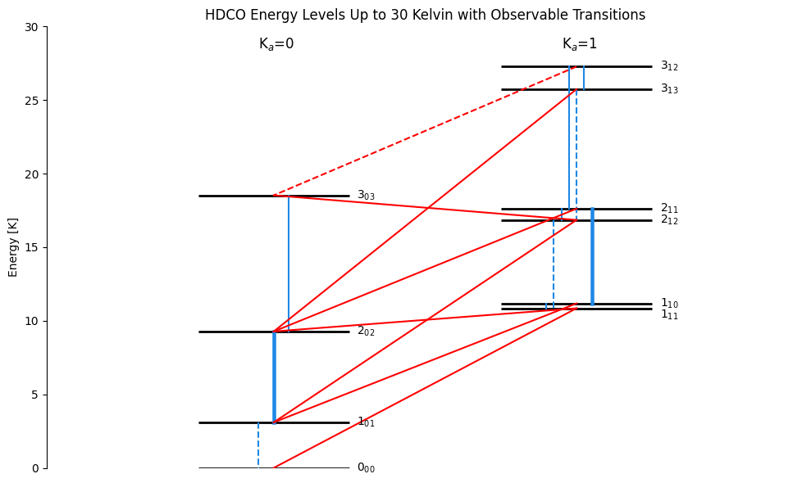
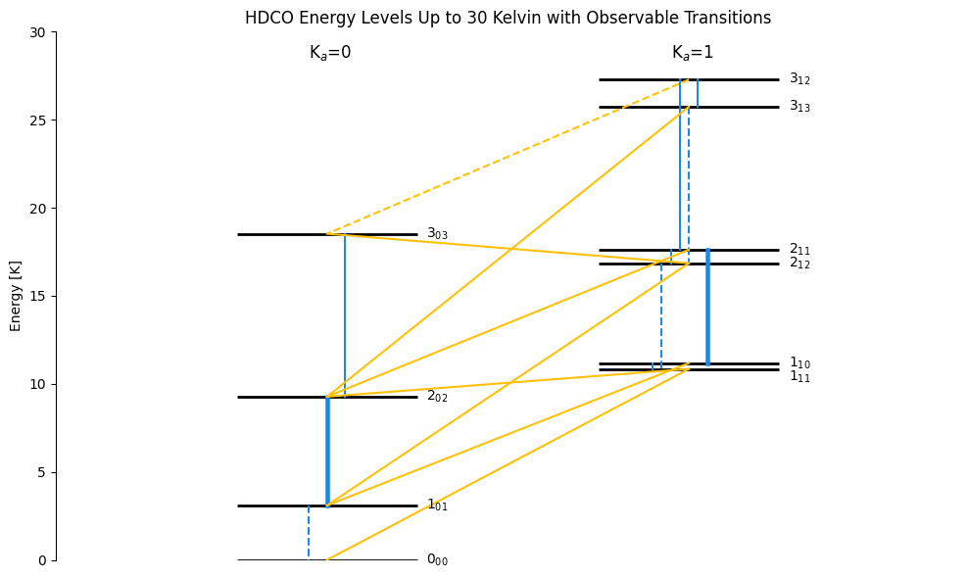
What We Observed
Energy [K]
Notes:
Molecule is rotating and can rotate in a bunch of different ways and each of these ways corresponds with a specific energy
As it changes from one way of rotating to another, it changes in energy
This change in energy emits radiation of a specific frequency that we can observe with radio telescopes
This diagram depicts all the possible transitions for deuterated formaldehyde up to 30 Kelvin (very cold,~ -406 F)
The different colors designate the different ways the molecule can change in rotation, the dotted lines designate transitions with frequencies that are hard to observe due to the atmosphere, and the bold lines designate the transitions that we observed for HDCO!

Slide 11
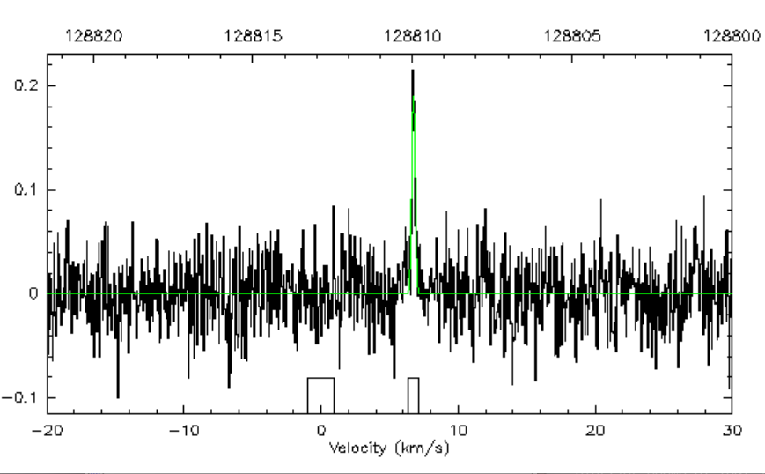
What We Observed
Used the Arizona Radio Observatory (ARO) 12m telescope
Took in spectra from HDCO at two frequencies and H₂CO at two frequencies
Made note of intensities to find column densities later
Seo 21 HDCO 128 GHz
Temperature (K)
Velocity (km/s)
Notes:
Using the ARO 12m telescope up on Kitt Peak, we observed HDCO at 2 frequencies as well as H2CO at two frequencies to account for the different possibilities of the arrangement of spin in the molecule. We spent the whole first semester observing these four transitions for each of the cores as the spectra you can see here. We made note of the height of the spike aka the intensity of the transition as we will use that to determine the column density next
Converting freq into velocity using doppler formula

Slide 12
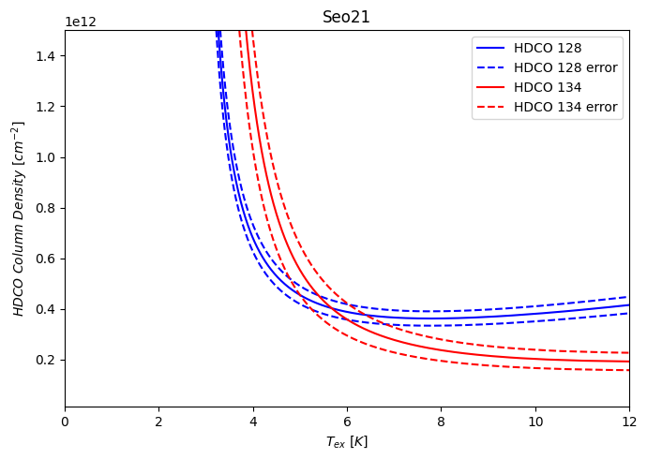
Determining Column Densities - HDCO
Adjust for beam efficiency
Assume optically thin
Graph column density versus excitation temperature
Where the solid lines cross gives us the column density and excitation temperature!
Seo 21
Column Density (cm^-2)
Excitation Temperature (K)
Notes:
We adjusted the intensities for both formaldehyde and deuterated formaldehyde to account for the beam efficiency (percent of the data that was actually able to be taken in by the telescope), then we were able to assume that the conditions to observe the deuterated formaldehyde were optically thin, meaning light passes through more easily, which simplified the calculations to simply multiplying a known set of column densities divided by intensities at each excitation temperature by the intensity observed in the spectra for each line for each core. This gives us our column density versus excitation temperature graph. The solid lines are the column densities from the known data set and the dotted lines are error bars. Where the solid lines cross gives us the Column Density we will use for the fractionation ratios and the excitation temperature (the temperature at which the energy transition is happening) to find the column density of formaldehyde

Slide 13
Determining Column Densities - HDCO
Adjust for beam efficiency
Assume optically thin
Graph column density versus excitation temperature
Where the solid lines cross gives us the column density and excitation temperature!
Seo 21
Column Density (cm^-2)
Excitation Temperature (K)
Notes:
We adjusted the intensities for both formaldehyde and deuterated formaldehyde to account for the beam efficiency (percent of the data that was actually able to be taken in by the telescope), then we were able to assume that the conditions to observe the deuterated formaldehyde were optically thin, meaning light passes through more easily, which simplified the calculations to simply multiplying a known set of column densities divided by intensities at each excitation temperature by the intensity observed in the spectra for each line for each core. This gives us our column density versus excitation temperature graph. The solid lines are the column densities from the known data set and the dotted lines are error bars. Where the solid lines cross gives us the Column Density we will use for the fractionation ratios and the excitation temperature (the temperature at which the energy transition is happening) to find the column density of formaldehyde

Slide 14
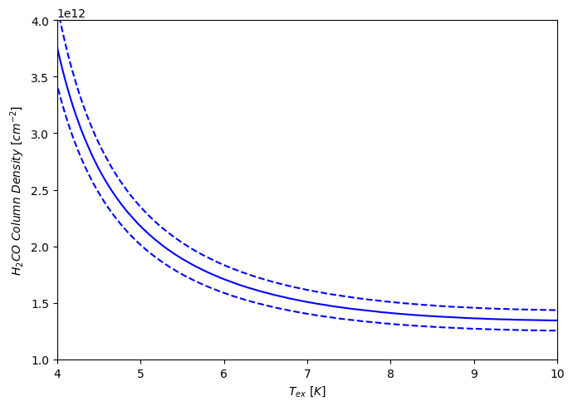
Determining Column Densities - H₂CO
Cannot assume optically thin limit
Integral much harder
Code to do it for us!
Use excitation temperatures from HDCO graphs to find column densities for H₂CO
Seo 21
Notes:
It’s a bit trickier to find the column densities for formaldehyde since we cannot make the same optically thin assumption we made for HDCO. This complicated the integral we have to do by a lot and makes it so we can’t just solve for the ratio of column density to intensity like before. Luckily, we have a piece of C code that does this integral for us! We give it the adjusted intensity, the width of the peak we observed, and the gas kinetic temperature found from a paper by Young Min Seo studying the Taurus Molecular Cloud and it returns a list of column densities by excitation temperature. So we use the excitation temperature we found previously to look up the column density from the output file, and now we have both column densities and can make our ratios for each core!

Slide 15
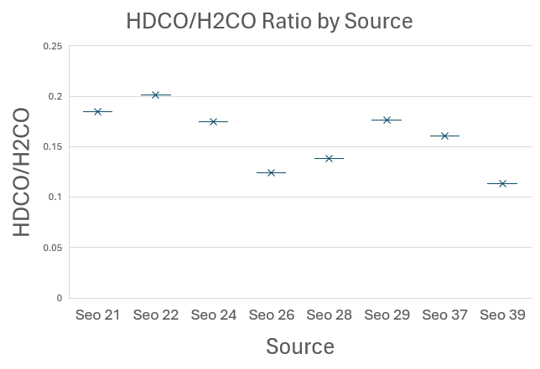
Preliminary Results/Moving Forward
Need to calculate error bars
But already seeing differences!
Comparing ratios with properties of filaments and cores within them
B213 E
B213 C
B218
Notes:
Now that we have the ratios for each of the cores, we can compare them to the other aspects of the core such like location and density. From this we can see if any of these other aspects have a relation to the evolution of the core or filament, providing a better understanding of these regions, their conditions, and thus the potential conditions for the birth of a star

Slide 16

Acknowledgements
Dr. Yancy Shirley
University of Arizona Space Grant Administration
Partially supported by an Astronomy and Astrophysics grant AST-2205474 from the National Science Foundation
Supported in part through the Arizona NASA Space Grant Consortium, Cooperative Agreement 80NSSC25M7084

Slide 17
Thank you!

